Slide 1
Meet the Teacher
Welcome to Year 6

Slide 2
Staff working within our class
In a morning Year 6 will be taught by either Mrs Graham or Miss Perry (you can find out your child’s morning group at the end of this meeting)
In an afternoon Hamilton class will be taught by Mrs Waywood and Rostron class will be taught by Mrs Graham
PPA is covered by Mrs Morris
Teaching Assistants – Mrs Anderson & Miss Riding

Slide 3
Topics covered this year
Autumn | Spring | Summer
Topic The Maya | Topic The Rainforest | Topic The Egyptians
Science Earth & Space Electricity | Science Forces | Science Living things and their habitats

Slide 4
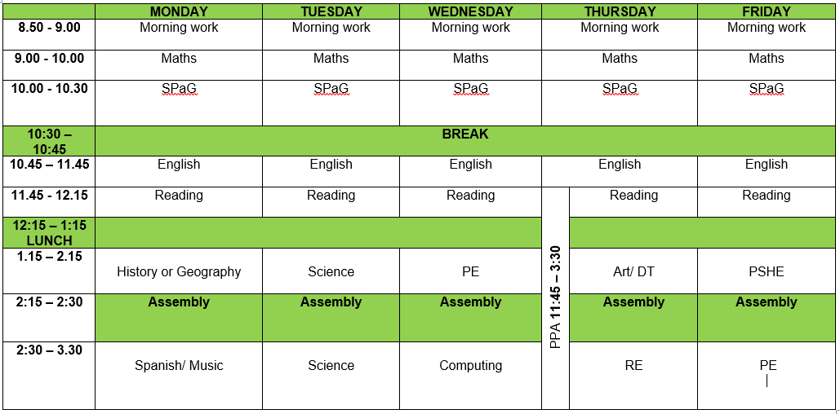
Timetable

Slide 5
SATs
You will be invited to a SATs meeting early in January, where we will explain what will happen in SATs week and what we will be doing in the run up to it.
At the beginning of Year 6 we use past SATs papers to test the children to see what they have remember from pervious year groups (as SATs tests test children on all knowledge from KS2) and to help inform what we teach in class. These test are nothing at all for the children to worry about and we are always very honest about why we do these test and that if there are questions they can’t answer, that is fine – it lets us know what we need to teach them, so that they can answer it next time.

Slide 6
Attendance and Punctuality
It is greatly important that your child arrives on time and attends every day. As soon as they enter the classroom, children will take part in a morning maths or an English activity to consolidate previous learning in class, equating to 50 minutes each week.
If for any reason they are absent, please let school know the reason for their absence on the first day.
Attendance at Hardy Mill is very important. As a school, we monitor attendance carefully and will notify you if your child’s attendance falls below national average. The government are also having a big push on attendance and issuing many more fines.
School day begins: 8.50am
School day finishes: 3.30pm

Slide 7
Routines in Year 6
Healthy snacks can be brought to school to eat at morning play time.
Please ensure your child has a water bottle in school each day. This must be taken home and washed daily.
Children may only bring a school book bag. No rucksacks or large bags will be allowed.
Children are not to bring their own pencil case.
Year 6 will be able to walk to and from school once consent has been given
Year 6 children will be able to cycle to and from school once an agreement has been signed

Slide 8
Routines in Year 6
P.E
Children must take part in PE sessions, if they cannot participate, please inform your child’s class teacher by email, letter or phone call.
PE Kit – Children should come to school on their PE days in their PE kit. Please ensure this fully adheres to our PE uniform.
No jewellery should be worn for PE.

Slide 9
Expectations in Year 6
Curriculum expectations
Children are expected to do their very best in every lesson.
Children are encouraged and expected to keep their handwriting neat and take pride in their presentation in all subjects.

Slide 10
How you can help at home
Homework
Homework will be set weekly on Showbie. Homework will focus on the basic skills your child needs to learn during their time in Year 6
Each week children will be expected to:
Learn spellings
Practise their times tables
Enjoy reading at home
Optional sheets from the box
Optional Learning Log Homework
Optional My Maths (My Maths & Box at the back)

Slide 11
How you can help at home
Regular home reading
Please write in your child’s reading record if they have read at home. Encourage them to talk about their reading with you.
Times tables
By the end of Year 4 your child is expected to know all of their times tables and associated division facts up to 12x12.
Spelling
During the year, your child will be taught a number of different spelling rules which they are expected to learn and apply. They will also revise the words from the Year 5/6 word list

Slide 12
Online Safety
Please continue to supervise your child whilst they are online.
Treat it as you would road safety – you wouldn’t show them how to cross the road once and then leave them, apply the same rules on the internet – reinforce online safety constantly!
Please visit www.commonsensemedia.org for app and website information to check whether sites and apps are appropriate for the age of your child.

Slide 13
Online Safety
Social media – for age 13+ with parental consent
Instagram and snapchat cause issues in school – please keep your child from using these apps if you can
If you allow them to use them, please monitor them and ensure they have strict privacy settings and only accept friends they know in real life (please check these regularly)
We have had pupils with open Instagram accounts with THOUSANDS of followers – please be safe and keep it secure!

Slide 14
Questions
Thank you for taking the time to listen to the presentation.
If you have any questions please do not hesitate to get in touch via email:
grahaml@hardymill.bolton.sch.uk
perryl@hardymill.bolton.sch.uk
waywoodm@hardymill.bolton.sch.uk

